Slide 1
Image Colorization using Deep ConvNets and GANs
By:
Chirag Wadhwa(03215002718)
Hardik Joshi(03915002718)
Rohit Shokeen(36415002718)
Mentor: Dr. Savita Ahlawat
Group No: 15

Slide 2
Introduction
The process of automatic image colorization has been of significant interest for several application areas including restoration of aged or degraded images. This problem is highly ill-posed due to the large degrees of freedom during the assignment of color information. Many of the recent developments in automatic colorization involve images that contain a common theme or require highly processed data such as semantic maps as input. In our approach, we attempt to fully generalize the colorization procedure using a Deep Convolutional Generative Adversarial Network. The technique features fusion layers that will allow us to elegantly merge local information dependent on small image patches.
We will leverage a large-scale scene classification database along with our own images to train our model and validate our approach with the past user studies and compare it against the already available state of the art colorization techniques.

Slide 3
Work to be Done
Visualization of benchmark models (RESnet, CNNs etc.) results on test images against results generated through our working model.
Comparison of accuracy metrics etc. with benchmark models.
Tabulating our found comparison results and incorporating them into our research paper.

Slide 4


Objectives
Preparing the dataset and training the ConvNet: A. Generalization and augmentation of compiled images and the available Google Places dataset to increase accuracy metrics on different domains of data. B. Preparing the training, cross validation and test sets by converting original RGB color painted images to intermediate grey-scaled images since it is difficult to obtain grayscale painting images in real world.
Processing Images and Training the Model: In implementation we will be using Tensorflow, OpenCV and Numpy libraries for most of the work. Since the cost of training is huge and we will migrate our whole work to Google Colab Notebooks. It gives us powerful GPUs and TPUs along with enough storage for our work. We will connect our drive to the virtual machine and move our input data to local storage of the computer and use checkpoint epochs to determine the training progress.

Slide 5
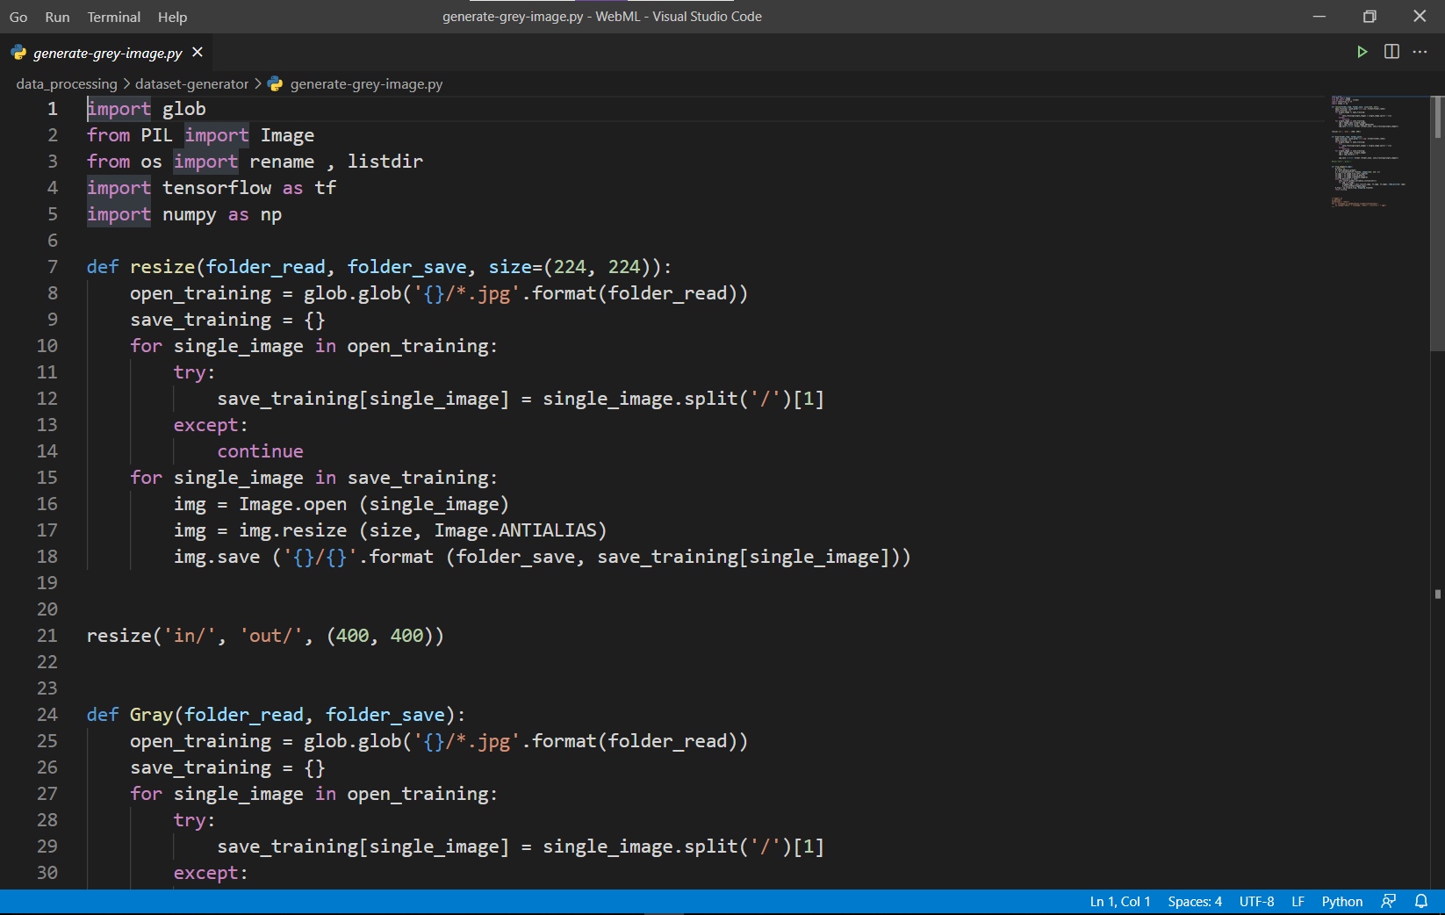
Work done until now
Resizing and Augmenting the training dataset images: Training set images are resized to a common default general size of (256*256). The images are also flipped from each side to have an augmented dataset.

Slide 6
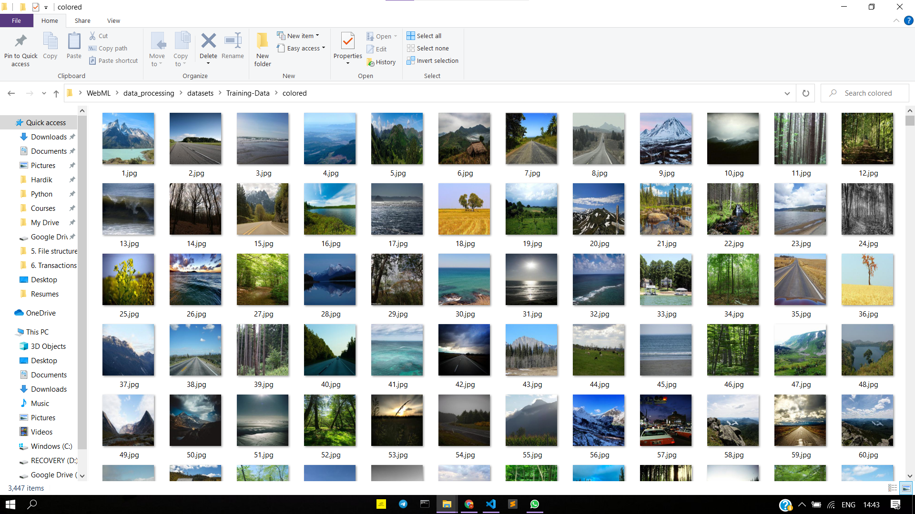
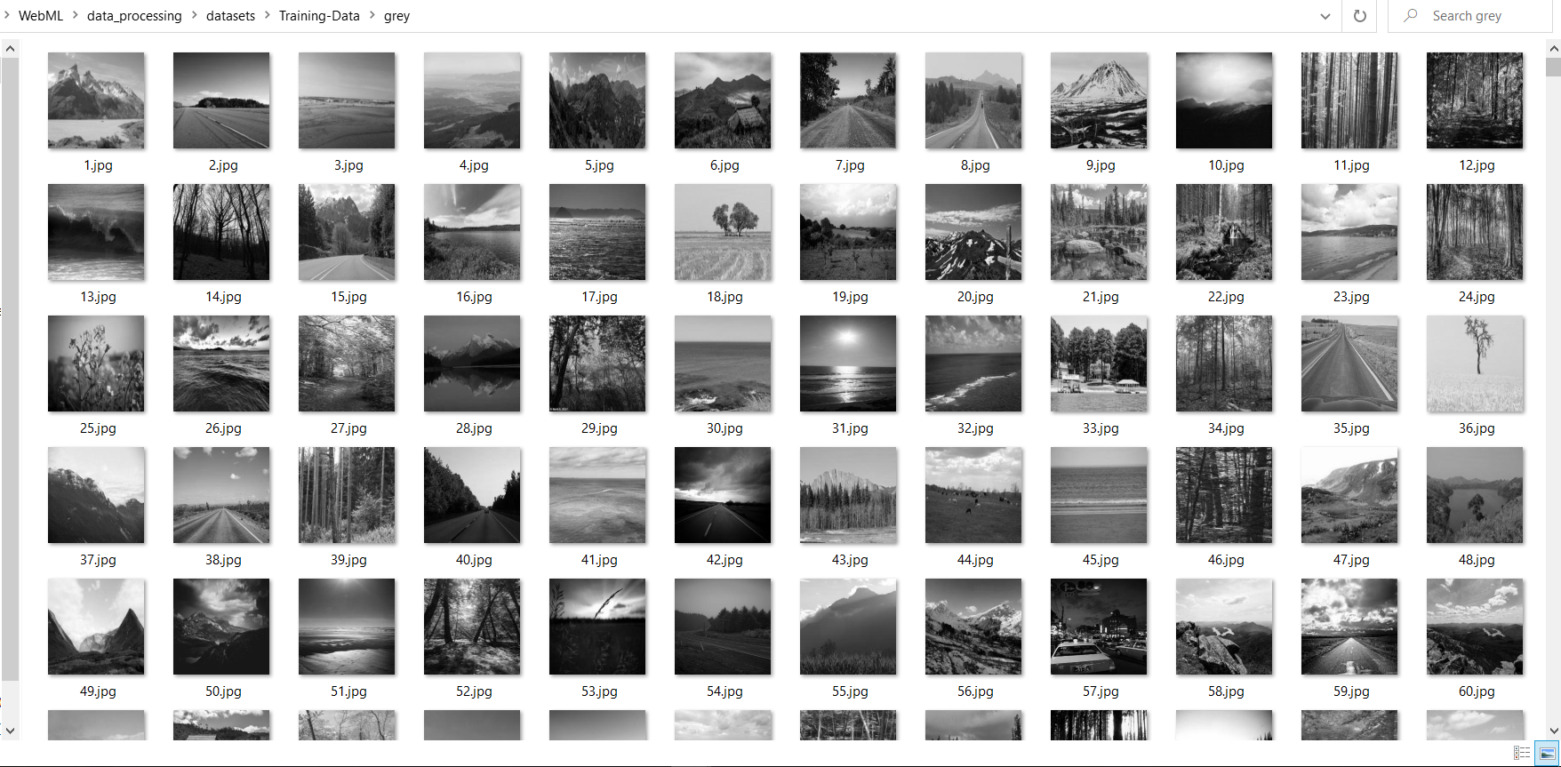
2. Grey scaling coloured training data images: The training data set images are converted to their grey-scaled counterparts. These will now be used to train the convnet model in a reverse fashion ie. the coloured ones will be used as result or the output image (Y) to learn the mapping function from X (ie. grey scaled images) to Y.

Slide 7
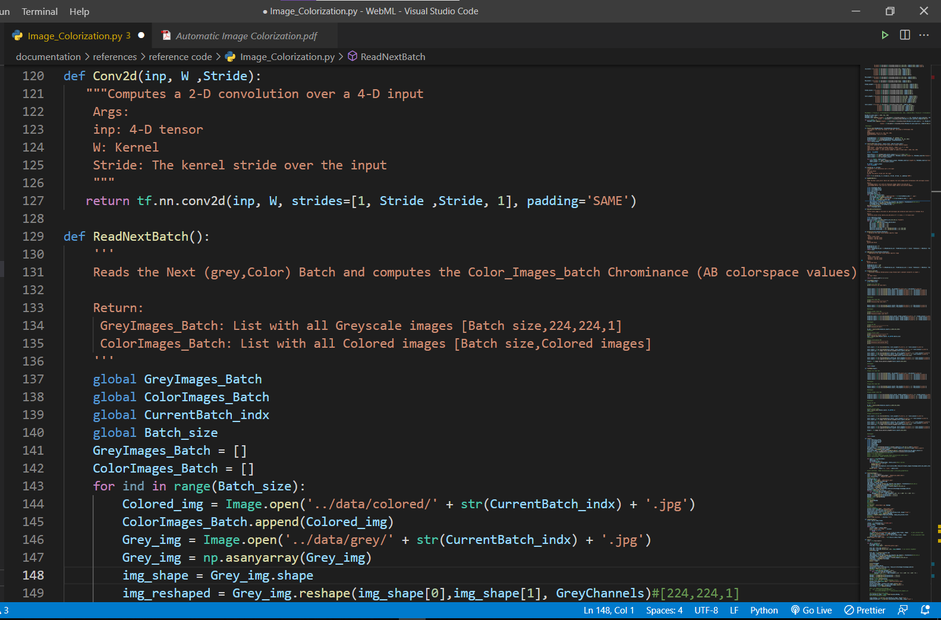
3. Building the Convolutional net: The Convnet model is trained on the grey scaled images as input and the corresponding result set (ie. coloured images). It will then further be used as the input dataline for the initialization for the GAN nodes (transfer learning).

Slide 8
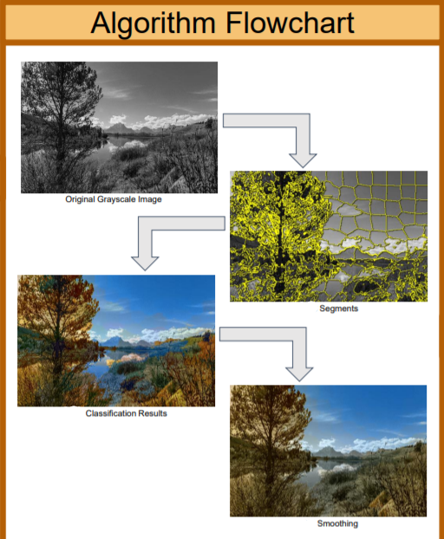
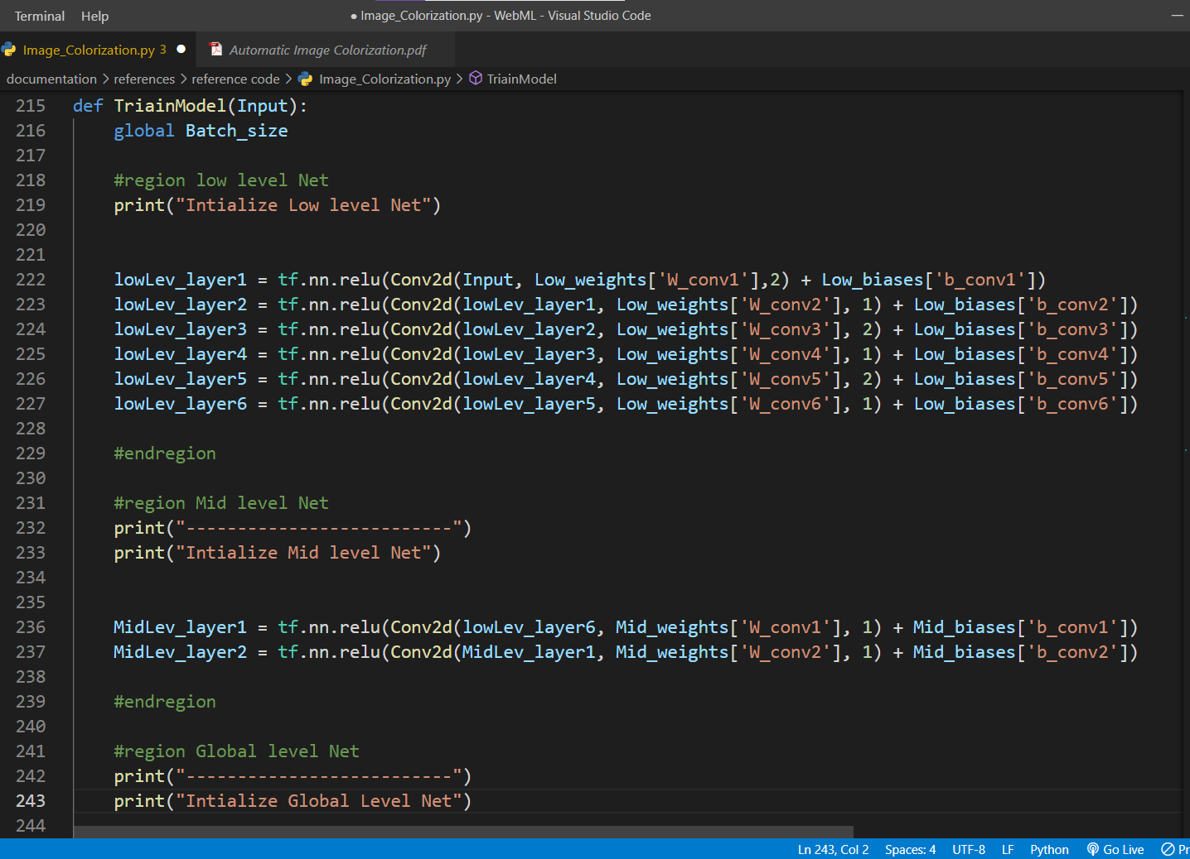
4. TRAINING THE MODEL: The model weights are trained. We have used RELU activation function for the layers and optimized our model by using ADAM optimizer.

Slide 9
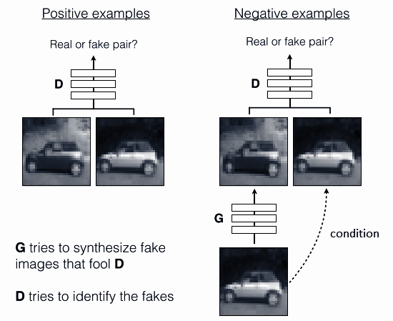
What is a Generative Adversarial Network:
GAN is a model in which two neural networks compete with each other to become more accurate in their predictions.
The two neural networks that make up a GAN are referred to as the generator and the discriminator.
The generator is a convolutional neural network and the discriminator is a deconvolutional neural network.
The goal of the generator is to artificially manufacture outputs that could easily be mistaken for real data. The goal of the discriminator is to identify which outputs it receives have been artificially created.
Intrinsic working of a Generative Adversarial Network (GAN)

Slide 10
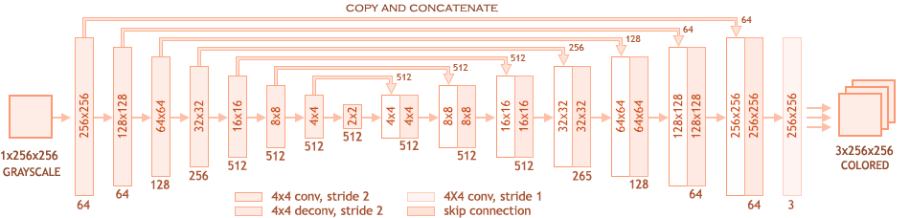
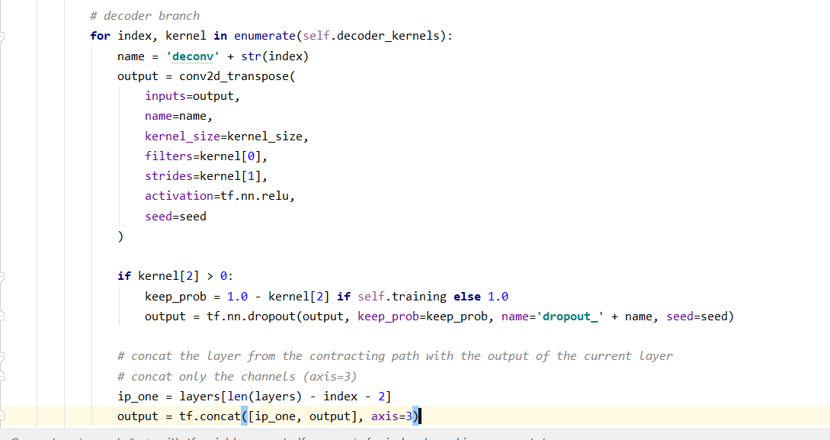
Code Implementation of above architecture (second last line from bottom shows the connection between layers back towards in the encoder being concatenated to the corresponding layer using tensorflow tf.concatenate)

Slide 11
Training our model
Dataset Used: Google Places 365 Dataset (Can be found at : http://places2.csail.mit.edu/download.html)
Hyperparameters used for training: Random Seed = 100 Batch - Size = 128 Epochs = 200 (1 epoch with nearly 50000 iterations nearly took 14-15 hrs on my machine !) Learning Rate = 1e-6 Learning Rate Decay Steps = 1e4 Beta (Adam Optimizer Momentum) = Default (0) Color Space = LAB (instead of RGB) Augment = True

Slide 12
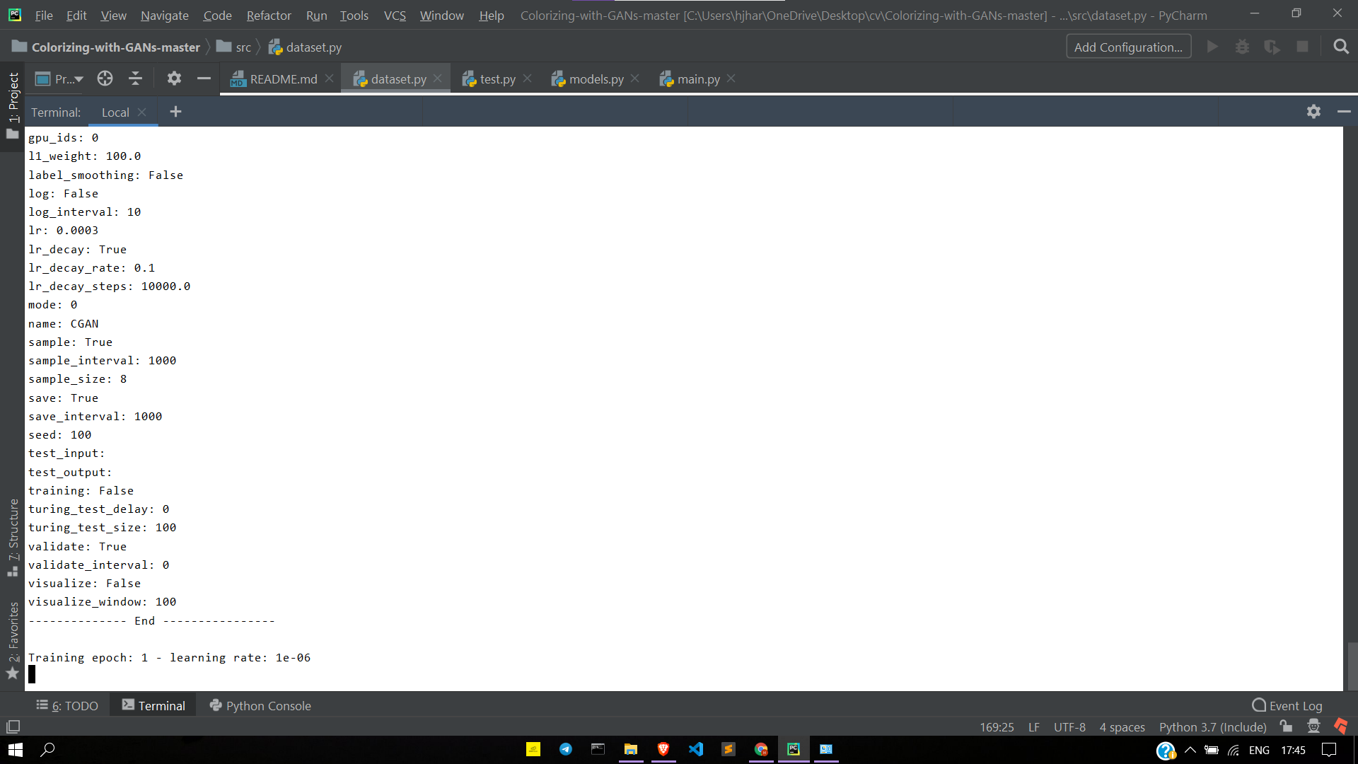
Snapshots
Training Start:

Slide 13
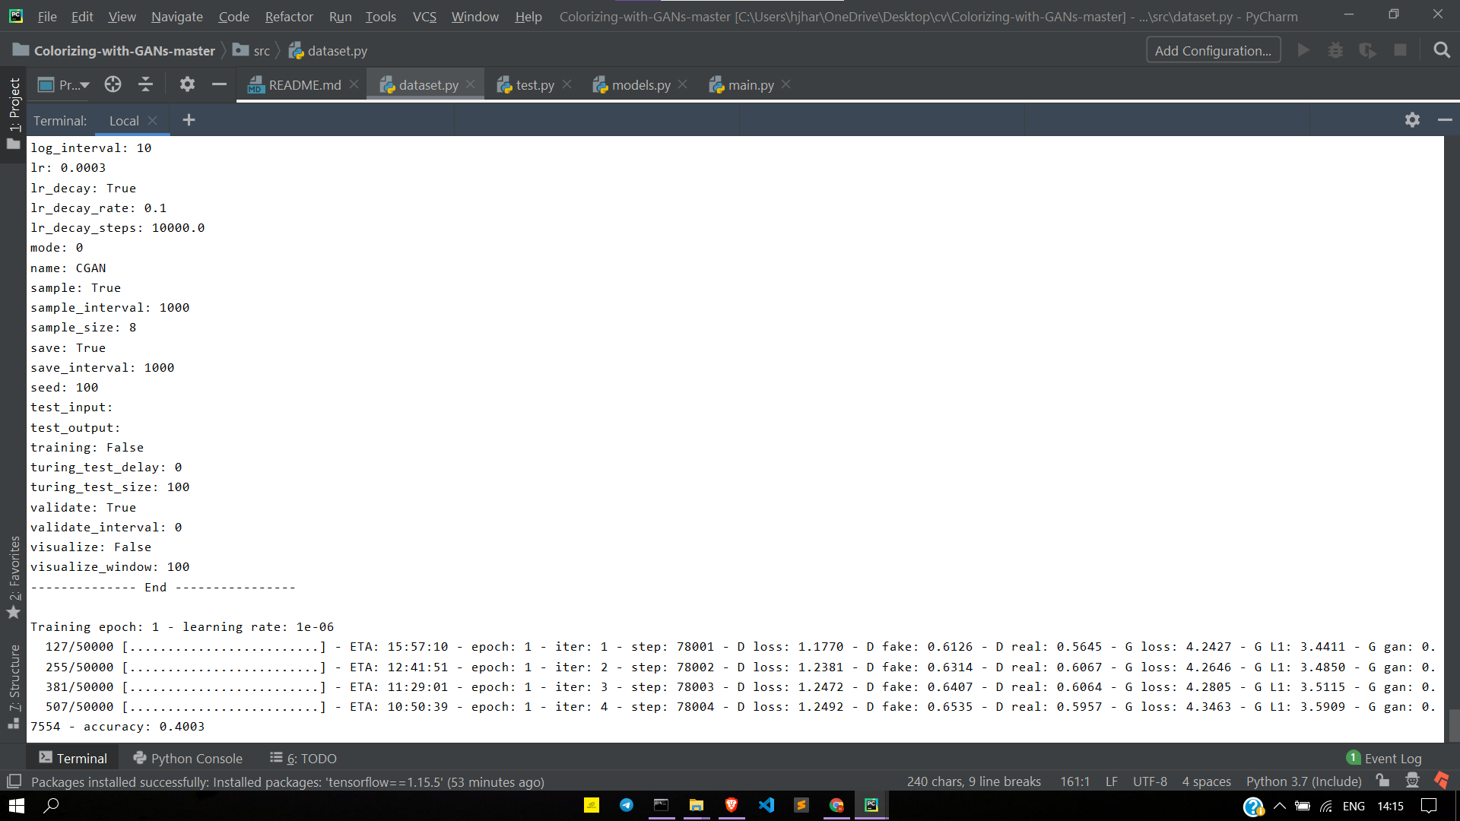
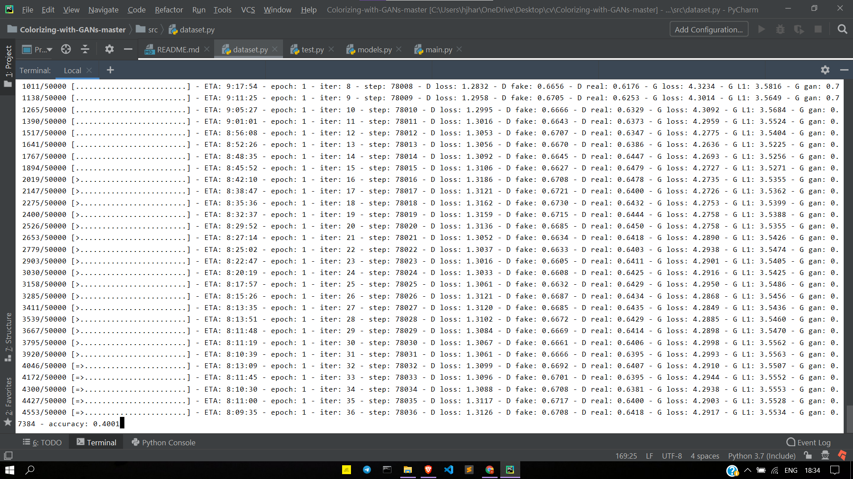
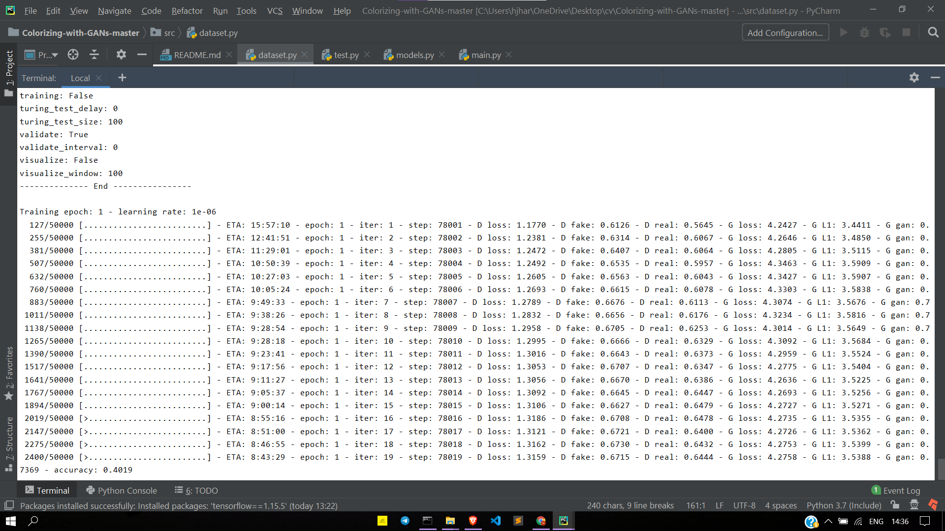
Training In Progress:

Slide 14
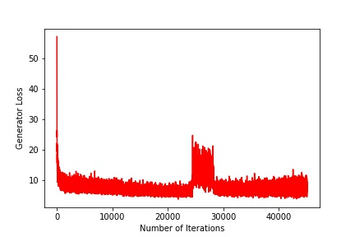
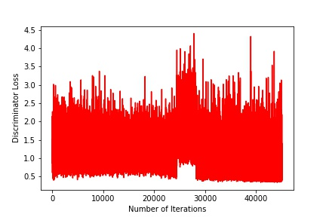
Metrics
Generator Loss (first epoch) Discriminator Loss (first epoch) (50000 iterations) (50000 iterations)
Loss | L | a | b
L1 Loss | 0.81 | 0.69 | 0.70
GAN | 0.87 | 0.74 | 0.84
L1+GAN | 0.86 | 0.84 | 0.82
Loss Metrics (L1 loss shows the loss for Deep ConvNet while GAN loss shows loss for the GAN architecture (both generator and discriminator) and the final loss is of the whole model compared to training dataset)

Slide 15
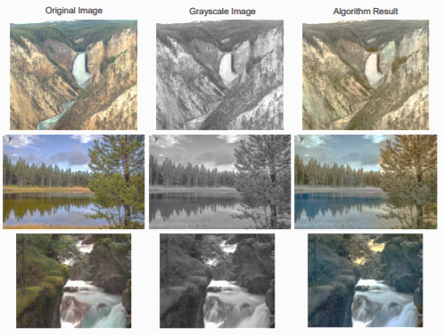
Previous Observations (during 1st progress):
Our current approach performs reasonably well (for a ConvNet), given the variety of colors and textures in the training set. The algorithm and model successfully shades our environmental features differently; as an example, the trees and their reflection in the second image are shaded with different colors.
However there is still need of improvement:
1. Over similar colors e.g. brown and dark yellow etc.
2. Clear boundary lines among intrinsic objects.
3. Hues of same colour (eg. blue, deep blue, turquoise blue, purple, etc.)
This is where our GANs come in. The output of this ConvNet will be connected to the input line for the GANs training. For quick and more accurate initialization of weights, we will initialize the weights of GANs layers with the output model of this trained ConvNet model. Thus having the combined benefits of both models.

Slide 16
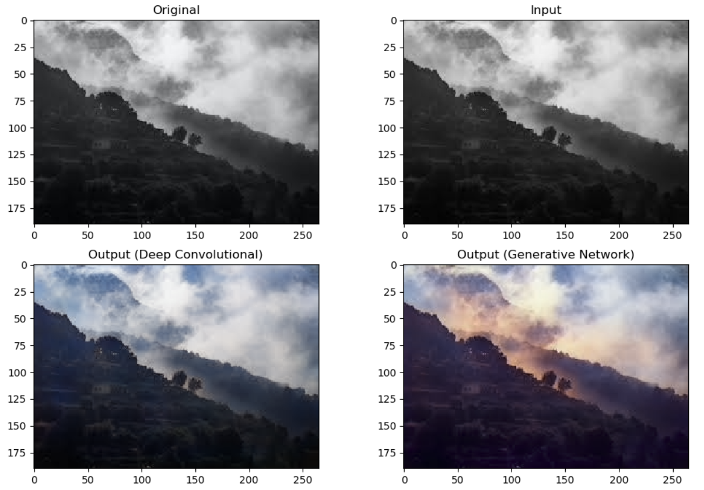
Working Snapshot

Slide 17
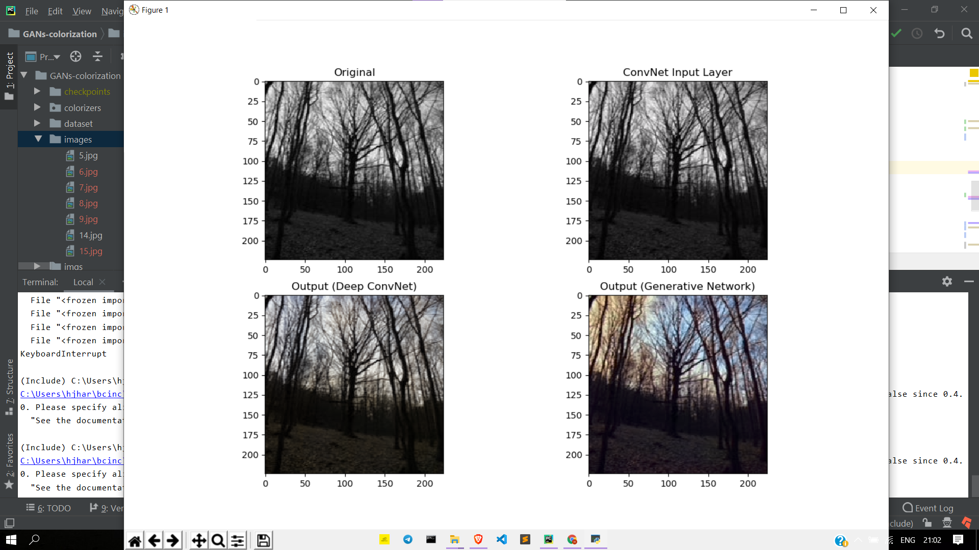

Slide 18
Observed advantages of our model compared to general CNN models
Differentiating among similar shades of different colours: Under certain circumstances, it was observed that the standard models were unable to differentiate among similar shades of different colours. For eg: certain light shades of brown were mixed with yellow and dark shades of yellow were considered as brown which created ambiguity in the final outcome.
Differentiating among boundary lines of objects: Under certain circumstances, it was observed that the standard models were unable to differentiate between the boundary lines of similar looking and similar colored objects For eg: scenes like yellowish sunlight along with yellowish farm scenes show high level of mixing capacity and the boundaries appear to be very blurred.
Differentiating among hues of same colours: Hue effects depend very much on the lighting conditions also. It is observed that scenes having the same colour hues altogether tend to combine both hues into one which is not a high priority problem but also cannot be neglected in certain unforeseeable conditions.

Slide 19
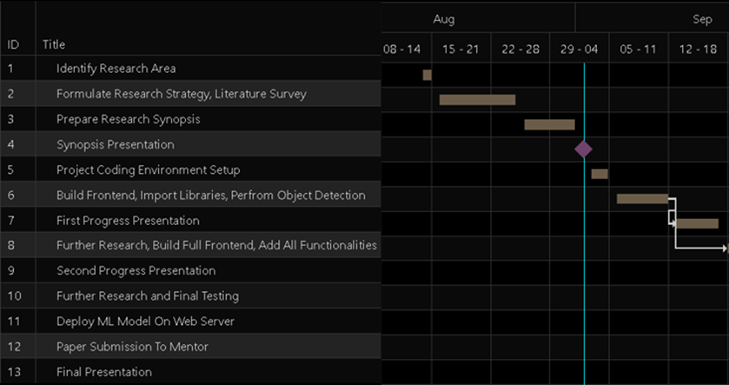
Project Timeline

Slide 20
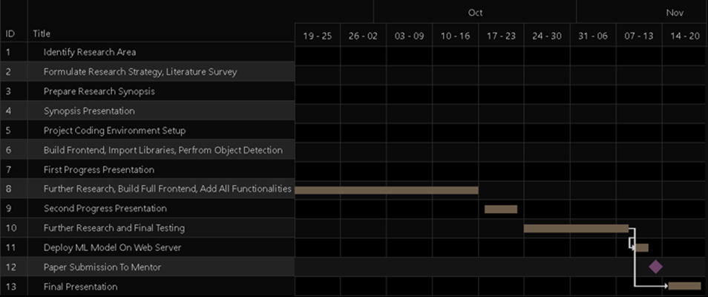
Project Timeline

Slide 21
References
1.Satoshi Iizuka, Edgar Simo-Serra and Hiroshi Ishikawa, “Let there be Color!: Joint End-to-end Learning of Global and Local Image Priors for Automatic Image Colorization with Simultaneous Classification”, in ACM Transactions on Graphics 2016, Volume 35 Issue 4, Article-110
2. Anwar, Saeed & Tahir, Muhammad & Li, Chongyi & Mian, Ajmal & Khan, Fahad & Muzaffar, Abdul, “Image Colorization: A Survey and Dataset”, in IEEE Winter Conference on Applications of Computer Vision (WACV), 2020
3. Z. Cheng, Q. Yang, and B. Sheng, “Deep colorization,” in IEEE International Conference on Computer Vision, 2015, pp. 415–423
4. S. Yoo, H. Bahng, S. Chung, J. Lee, J. Chang, and J. Choo, “Coloring with limited data: Few-shot colorization via memory augmented networks,” in IEEE Conference on Computer Vision and Pattern Recognition, 2019, pp. 11 283–11 292.

Slide 22
References
5. Z. Zhao, P. Zheng, S. Xu, and X. Wu, “Object detection with deep learning: A review,” in IEEE Transactions on Neural Networks and Learning Systems, vol. 30, no. 11, pp. 3212–3232, 2019
6. W. Luo, Y. Li, R. Urtasun, and R. S. Zemel, “Understanding the effective receptive field in deep convolutional neural networks”, CoRR, vol. abs/1701.04128, 2017.
7. P. Kr¨ahenb¨uhl, C. Doersch, J. Donahue, and T. Darrell, “Data-dependent initializations of convolutional neural networks”, CoRR, vol. abs/1511.06856, 2015

Slide 23
Thank You!

